Slide 1

BRAIN TUMOUR DETECTION USING CNN ALGORITHM
Presented by:
Name : KAKI VARAPRASAD
Reg No : 22A91F0019
ADITYA ENGINEERNING COLLEGE
Internal Guide:
Mr. A.Samyul, M.Tech

Slide 2
INDEX
ABSTRACT
EXISTING SYSTEM
DISADVANTAGES
PROPOSED SYSTEM
ADVANTAGES
SYSTEM ARCHITECTURE
ALGORITHM
ALGORITHM DESCRIPTION
FUNCTIONAL REQUIREMENTS
NON-FUNCTIONAL REQUIREMENTS
SYSTEM REQUIREMENT SPECIFICATIONS
UML DIAGRAMS
TEST CASE SPECIFICATION TABLE
SCREENSHOTS
CONCLUSION

Slide 3
ABSTRACT
Brain tumours pose a significant health threat and early detection is crucial for effective treatment. In this project, I propose an automated system for brain tumour detection leveraging machine learning and image processing techniques. The system begins by preprocessing magnetic resonance imaging (MRI) scans to enhance image quality and remove noise. Subsequently, features are extracted from the preprocessed images using advanced image processing algorithms.

Slide 4
EXISTING SYSTEM
The existing system for brain tumour detection relies heavily on manual interpretation of MRI scans by radiologists. This process is time-consuming and prone to human error. Additionally, it may result in delays in diagnosis and treatment initiation. Furthermore, the current system lacks scalability and consistency across different healthcare facilities. Overall, there is a need for automated systems to enhance the efficiency and accuracy of brain tumour detection.

Slide 5
DISADVANTAGES
Manual interpretation of MRI scans for brain tumour detection is subjective and can vary between different radiologists, leading to inconsistencies in diagnoses.
The current system relies on radiologists to analyze each MRI scan individually, which is a time-consuming process.
Manual interpretation is prone to human error, including misinterpretation of imaging features, it delays treatment.

Slide 6
PROPOSED SYSTEM
The proposed system utilizes advanced machine learning and image processing techniques to automate the detection of brain tumours from MRI scans. It enhances accuracy and efficiency by extracting features and classifying images into tumorous and non-tumorous categories. By leveraging computational algorithms, it offers consistent and objective results, reducing the reliance on subjective human interpretation. The system aims to expedite the diagnostic process, facilitating early detection and treatment initiation for improved patient outcomes. Its scalability and adaptability make it a promising solution for enhancing brain tumour detection in healthcare settings.

Slide 7
ADVANTAGES
It gives more accurate and consistent brain tumour detection compared to manual interpretation, reducing the risk of misdiagnosis.
Handle a larger volume of MRI scans efficiently.
By minimizing the reliance on subjective human interpretation, the system generates more objective results, reducing the variability between different radiologists.

Slide 8
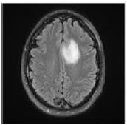

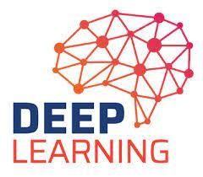


SYSTEM ARCHITECTURE
4
.2
Dataset Collection
MRI Images
Pre Processing
Web App
User
Classification

Slide 9
ALGORITHM AND DESCRIPTION
The CNN (Convolutional Neural Network) algorithm is a type of deep learning algorithm specifically designed for analyzing visual data, such as images or videos. It is widely used in various computer vision tasks, including image classification, object detection, and image segmentation.
The main components of a CNN algorithm include convolutional layers, pooling layers, fully connected layers, and activation functions.
Convolutional Layers:
This layer is the first layer that is used to extract the various feature from the input images. In this layer, the mathematical operation of convolution is performed between the input image and filter of a particular size of MxM. By sliding the filter over the input image, the dot product is taken between the filter and the parts of the

Slide 10
input image with respect to the size of the filter.
Pooling Layers:
The Second layer is the pooling layer. In most cases, a convolutional layer is followed by a pooling layer. The primary aim of this layer is to decrease the size of the convolved feature map to reduce computational costs. This is performed by decreasing the connections between layers and independently operates on each feature map.
Fully Connected Layers:
The Third layer Fully Connected (FC) layer consists of the weights and biases along with the neurons and is used to connect the neurons between two different layers. These layers are usually placed before the output layer and from the last few layers of a CNN Architecture.

Slide 11
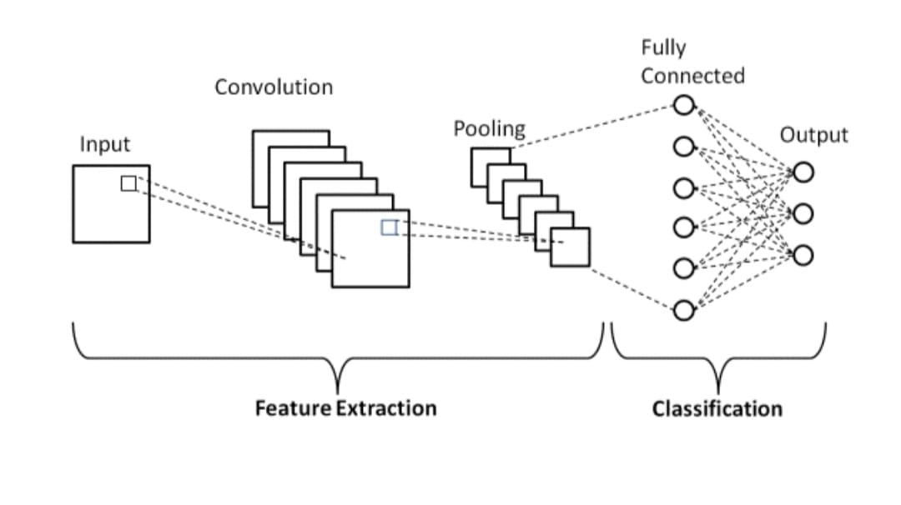

Slide 12
FUNCTIONAL REQUIREMENTS
The system should pre process MRI scans to enhance quality and remove artifacts, employing techniques like noise reduction, contrast enhancement, and normalization.
It must extract relevant features from pre processed images using algorithms like wavelet transform, histogram analysis, or region-based methods to capture tumour-specific characteristics.
Provide an intuitive user interface for healthcare professionals to upload MRI scans, initiate the detection process, and view the results, ensuring ease of use and accessibility in clinical settings.

Slide 13
NON-FUNCTIONAL REQUIREMENTS
Scalability: The system should efficiently handle large volumes of data, recommendations
Reliability: The system should be available for minimal downtime.
Security: It provides better security for the data.
Usability: The system should be accessible to users with disabilities, complying with relevant accessibility standards.
Maintainability: The system should be modular and well-structured, allowing for easy maintenance.

Slide 14
SYSTEM REQUIREMENT SPECIFICATIONS
Software Requirements:
Operating System : Windows 11
Domain : Machine Learning
Technologies : Python 3.11
Tools : VS code
Hardware Requirements:
Processor : intel i3 and above
Hard Disk : 500 GB
Speed : 3.8 GHz
RAM : 8 GB

Slide 15
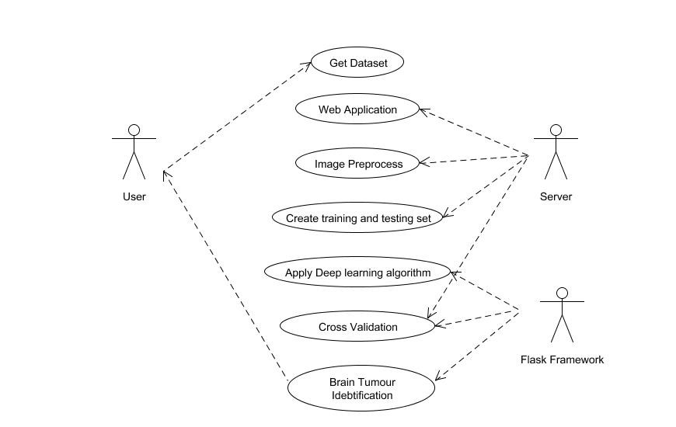
UML Diagrams Usecase diagram :

Slide 16
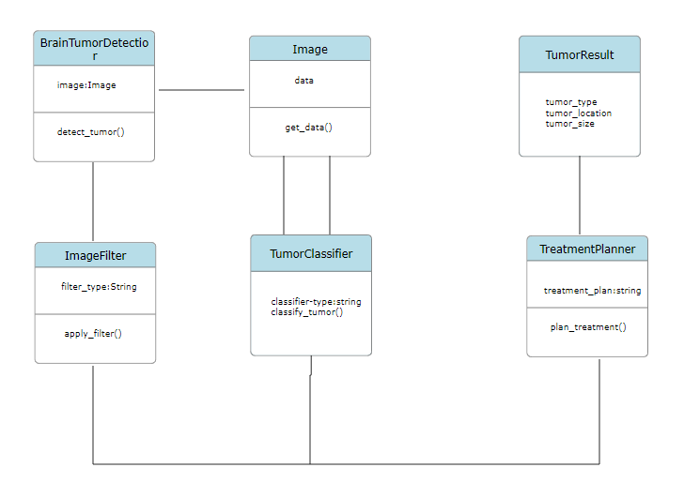
Class diagram:

Slide 17
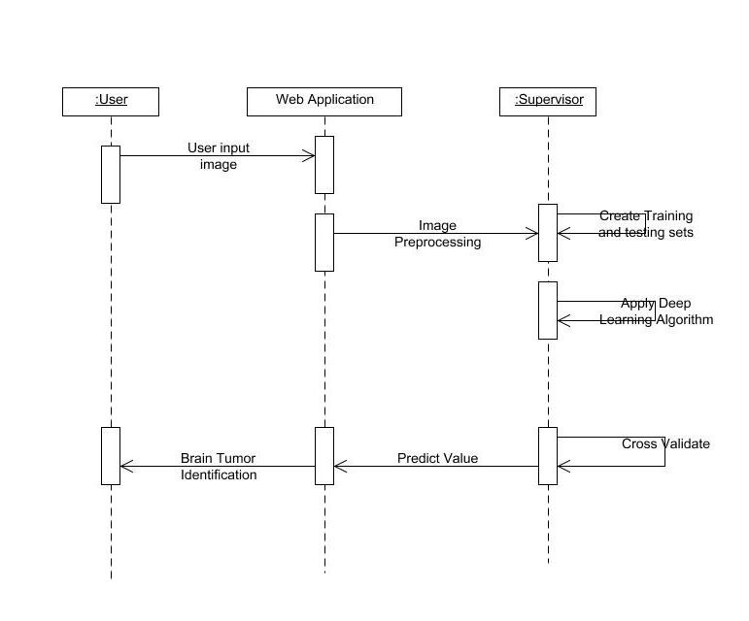
Sequence diagram :

Slide 18
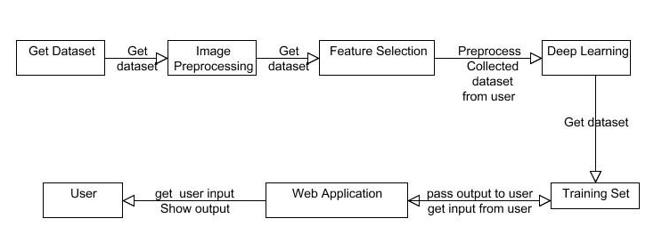
Collaboration diagram :

Slide 19
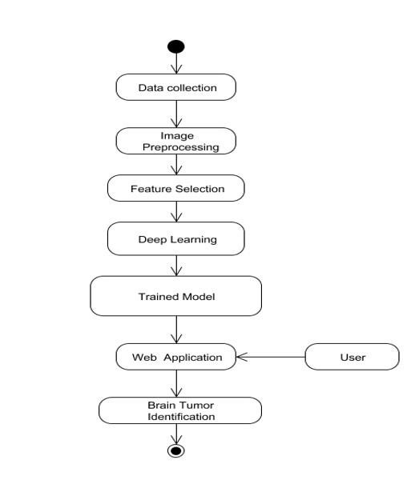
Activity diagram :

Slide 20
Test case specification table
Test Case id | Test Case Name | Input | Expected output | Observed output | Result
T1 | Tumor detection | MRI image | Display the name of tumor | Tumor name is displayed | Pass
T2 | Tumor detection | Normal image | Error message will be display | Error was displayed | Fail

Slide 21

Screenshots

Slide 22
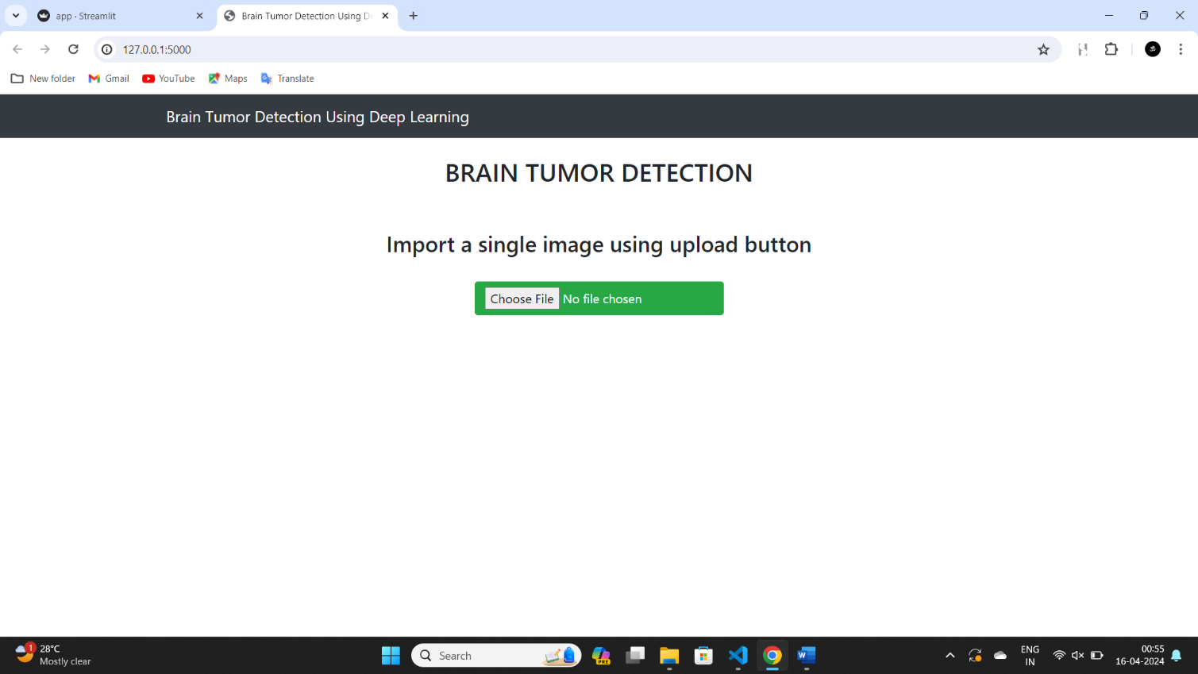

Slide 23
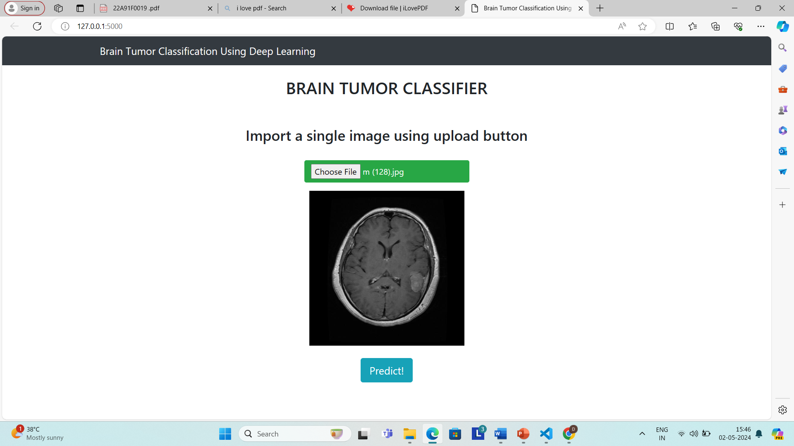

Slide 24
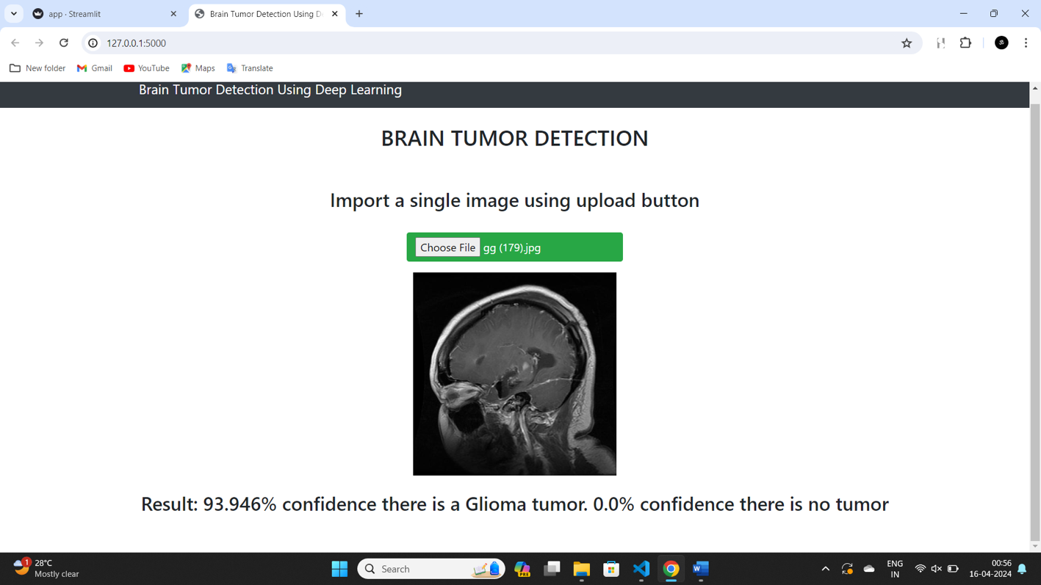

Slide 25
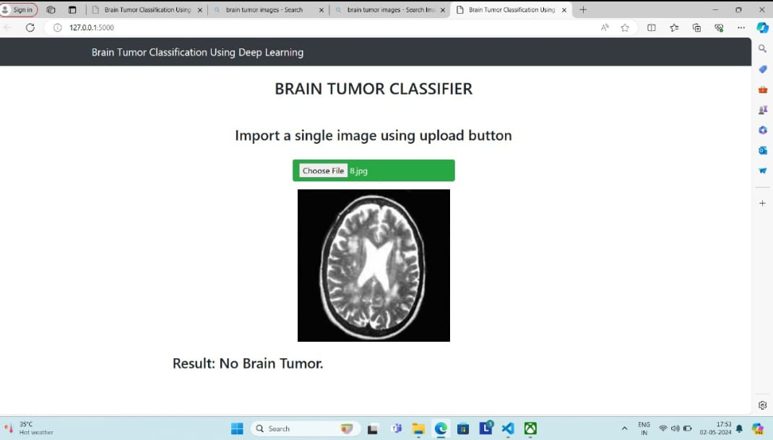

Slide 26
Conclusion
In conclusion, the development of a brain tumour detection system based on CNNs represents a significant advancement in medical imaging technology. The successful implementation of this system could improve the accuracy and speed of brain tumour diagnosis, leading to better patient outcomes.
The use of transfer learning techniques and CNN architecture has demonstrated high precision and accuracy in detecting brain tumours in medical images. This system has the potential to assist medical professionals in making timely and accurate diagnoses, which can help improve patient survival rates and quality of life.
Future research in this area could explore the use of other CNN architectures and incorporate more extensive datasets to improve the accuracy and reliability of the system. Additionally, efforts could be made to integrate the system with electronic medical record systems to streamline the process of accessing and analyzing medical images.

Slide 27
THANK YOU

